Slide 1
Humanist Discourse in Mann’s Faustus: Rereading the Novel in Light of the Contemporary Refugee “Crisis” in Europe
Alvina Ahmed
Faculty Advisors: Dr. Vanessa Plumly, Dr. Patricia Sullivan

Slide 2
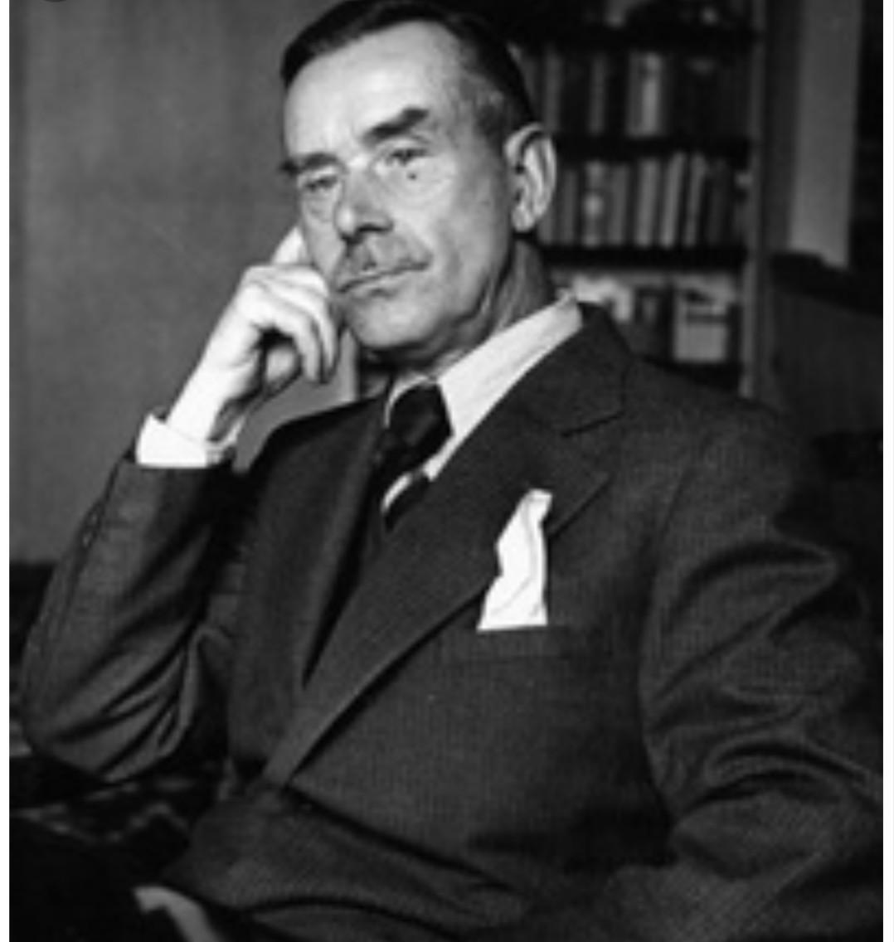
Thomas Mann (1875-1955)
German author
Turn of the century to WWII
Publicly spoke against Nazism
Exiled in Switzerland and later in the US

Slide 3
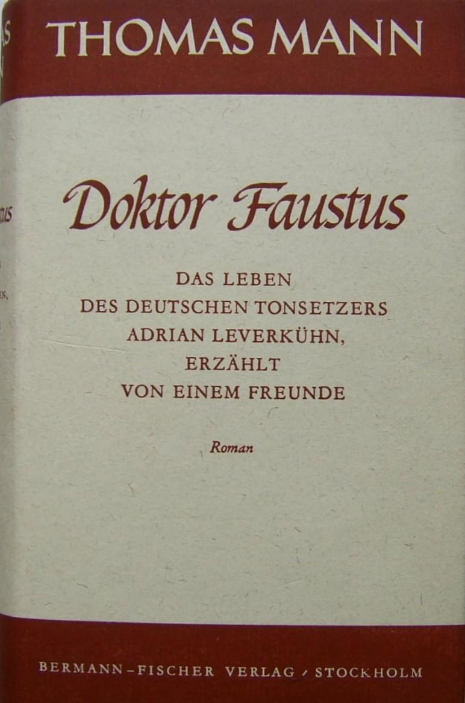
Doctor Faustus: The Life of the German Composer, Adrian Leverkuhn, as told by a Friend (1947)
Form of a biography of a brilliant musician who makes a faustian pact
Narrated by his friend, Serenus Zeitblom
Traditionally read as an allegory to Nazi Germany

Slide 4
Questions
Is Zeitblom’s narration accurate?
Is Leverkuhn a Humanist who warns “intellectuals” about the possible downfall of culture?
How is a 20th century political novel, such as Doktor Faustus, relevant in contemporary Europe in the midst of the refugee ‘crisis?’

Slide 5

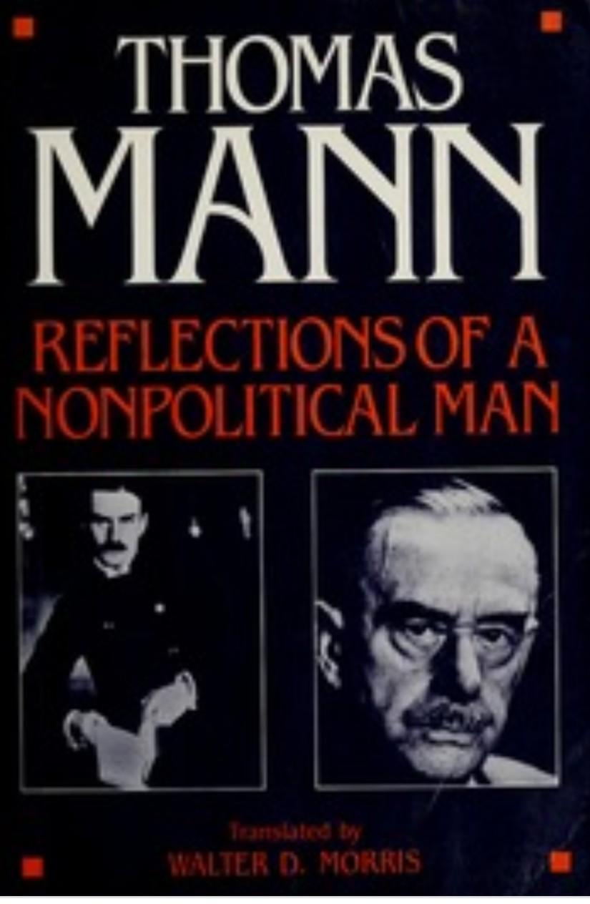
Mann’s views on politics

Slide 6
Mann: How can one define “politics?”
“Opposite of aestheticism”
“Salvation from aestheticism”
Criticizes supporters of the aesthetic movement, namely Arthur Schopenhauer

Slide 7
Downfall of German Culture
1914-1918: Mann writes Reflections of a Non-Political Man warning about the potential downfall of his nation’s culture
1933: Rise of the National Socialist German Workers’ Party (NSDAP)

Slide 8
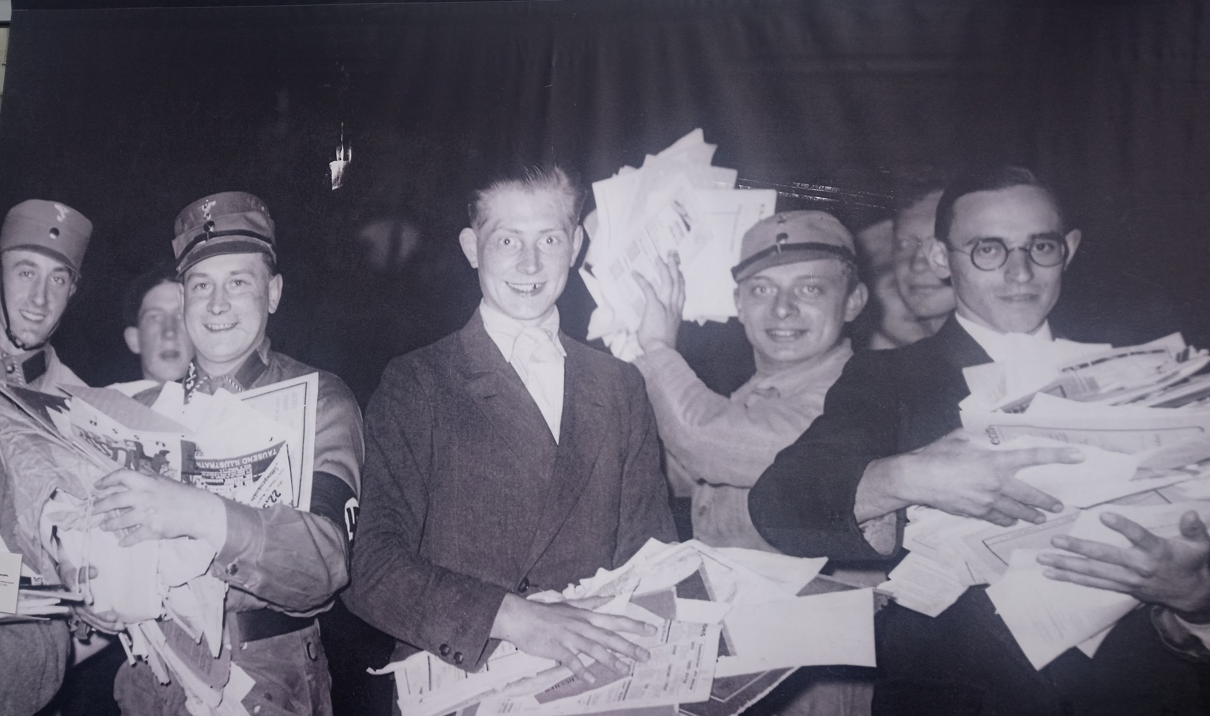
1933 Book Burnings and Goebbels’ Writers Union
Image taken at the Topography of Terrors, Berlin

Slide 9
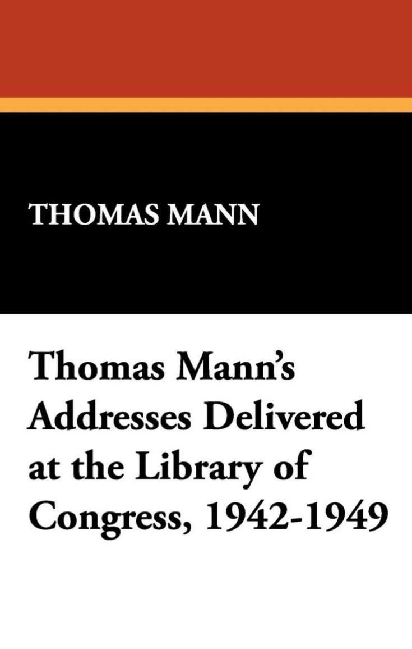
Is Doktor Faustus a condemnation of German culture?
“Evil Germany is good Germany
gone astray” - T. Mann, 1946

Slide 10
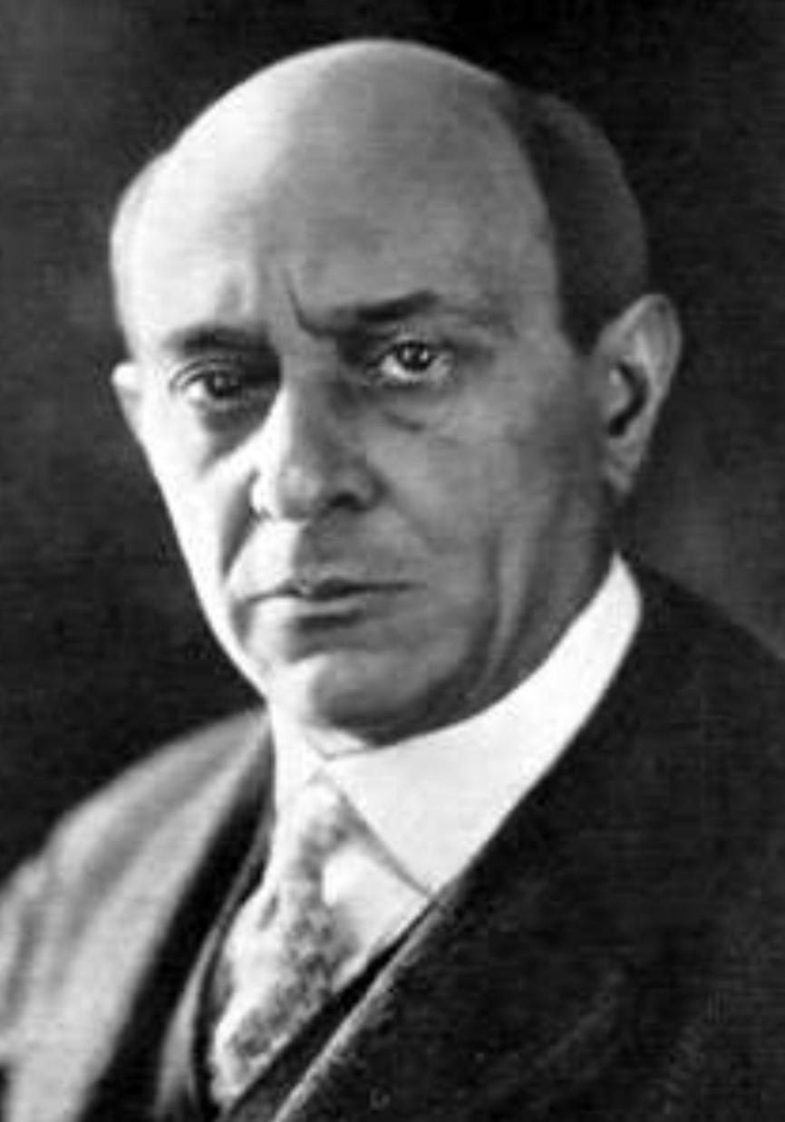
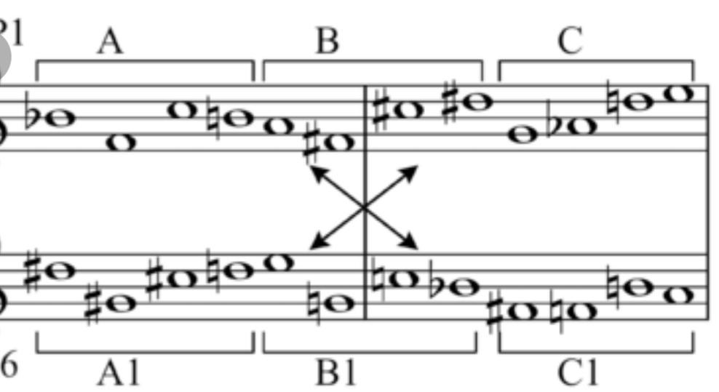
12 Tone Technique
Developed by Viennese composer Arnold Schoenberg
Ensures that all 12 notes of the chromatic scale are sounded as often as one another while preventing the emphasis of any one note

Slide 11
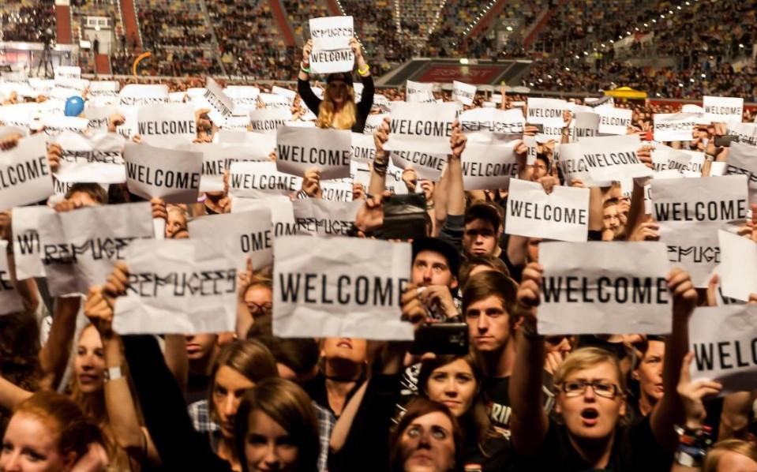

Reading Doktor Faustus Today
In 2015, an estimated 2.2 million refugees entered the EU
Willkommenskultur in Germany

Slide 12
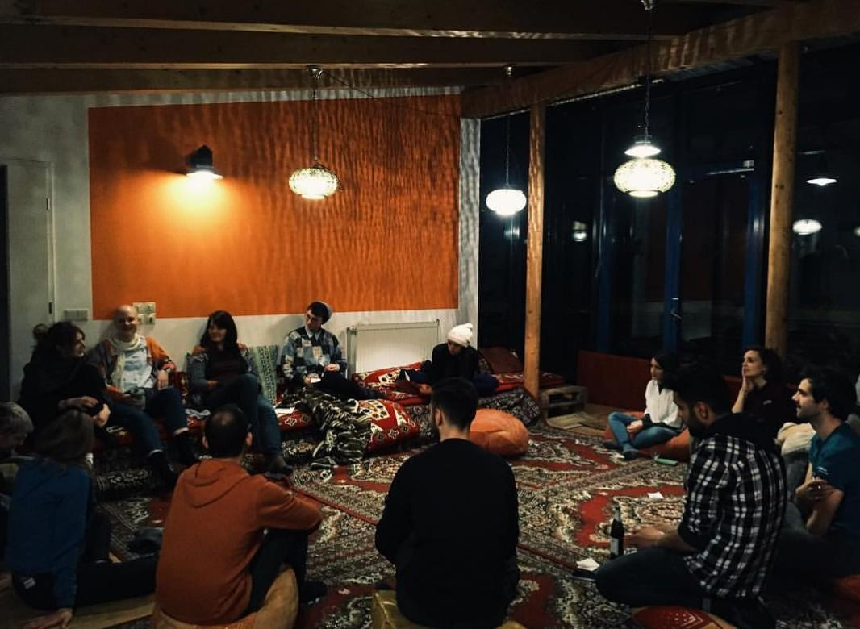
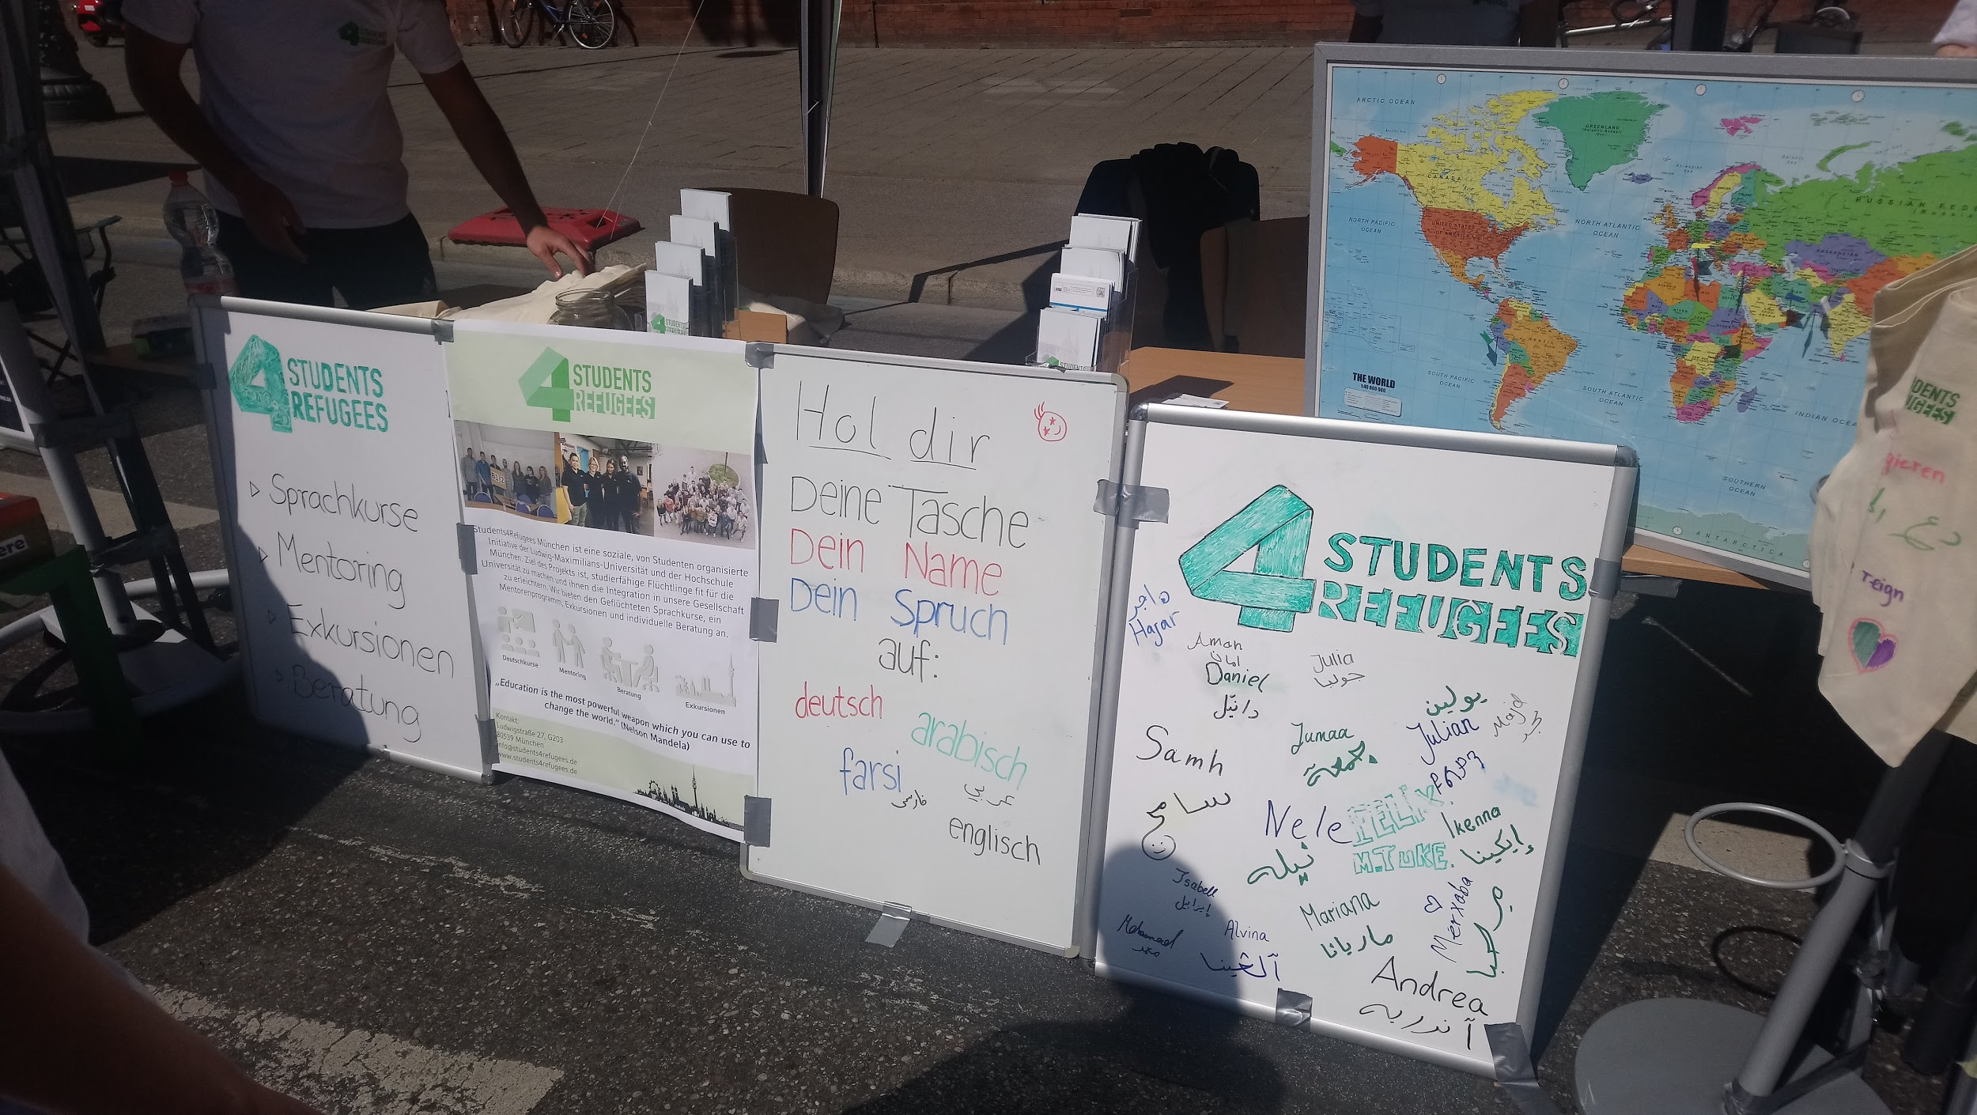

Modern Humanism: What actions can be taken?

Slide 13
Conclusion

Slide 14
Bibliography
Craig, Gordon. Deutsche Geschichte 1866-1945. Munich: C.H. Beck, 1980.
Mann, Thomas. Betrachtung eines Unpolitischen. Berlin: S. Fischer, 1918, Erste Neuauflage 1920.
Martin, Benjamin. ‘’European Literature in the Nazi New Order: The Cultural Politics of the European Writers’ Union 1941-3.’’ Uppsala: Journal of Contemporary History, 2013.
Lischeid, Thomas. Symbolische Politik: das Ereignis der NS-Bücherverbrennung 1933 im Kontext seiner Diskursgeschichte. Heidelberg: Synchron, 2001.
Sauder, Gerhard, editor. Die Bücherverbrennung: zum 10. Mai 1933. München: Hanser 1983.
Vaget, Hans Rudoplh. A Companion to the Works of Thomas Mann. Rochester: Camden House 2004.

